Slide 1
LAB 7: KERNEL MODULE & CHARACTER DRIVER
Dr. Kazi Md. Rokibul Alam & JAKARIA
Modified by: Abdul Aziz

Slide 2
KERNEL MODULE
The kernel is the core of any operating system and is responsible for managing system resources. Broadly, the Linux kernel can be of two types.
Monolithic kernels: This is a single executable file in which all the modules are part of the kernel. In order to add anything to the existing kernel, developers have to rebuild the complete kernel and add the new functions.
Modular kernels: Modular kernels provide developers an option to add new functionality to the existing kernel by plugging the new code, also known as ‘modules’ at run time.

Slide 3
KERNEL MODULE
What are kernel modules?
Kernel modules are pieces of code, which can be loaded and unloaded from a kernel, on demand. A Linux Kernel Module (LKM) can be added at run time without even requiring a reboot or even a rebuild of the running kernel. The LKM will have a.ko extension.
The LKM will act as the interface between a user space application and the Linux kernel. Any request to access the hardware from an application goes via the LKM to the kernel, and then to the actual hardware (see Figure in the next slide).
To know the list of modules running in a Linux kernel you can use the ‘lsmod’ command, which actually gives the list of running modules at that point of time, by reading ‘/proc/modules’ as shown in Figure.
Kernel modules can be broadly categorized as character, block or network modules.

Slide 4
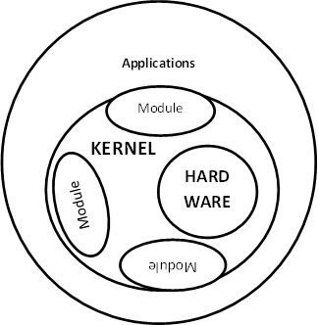
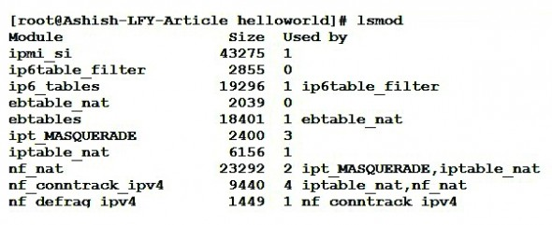
KERNEL MODULE

Slide 5
KERNEL MODULE
Kernel module management commands:
insmod <module-name>: This command is to insert the new module into the kernel
lsmod: This lists the modules that are currently loaded in the kernel
modinfo <module-name>: This is to get complete information about the module
rmmod <module-name>: This command is to remove the module from the kernel
modprobe <module-name>: This works the same as insmod but it uses ‘Module Stacking’ to load any module that is required to load the current module.
modprobe r <module>: To remove the module from the kernel
dmesg: Shows the contents of the kernel ring buffer
For an example of how to use module management commands, please refer to Figure in the next slide.

Slide 6
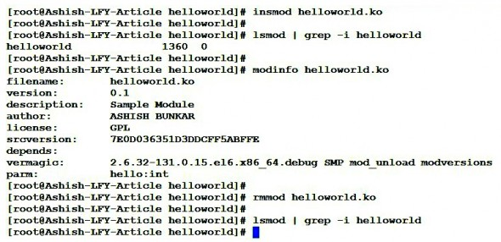
KERNEL MODULE

Slide 7
KERNEL MODULE
#include <linux/init.h>
#include <linux/module.h>
int hello_init(void){
printk(KERN_ALERT "TEST: Hello world\n");
return 0;
}
void hello_exit(void){
printk(KERN_ALERT "TEST: Good bye\n");
}
module_init(hello_init);
module_exit(hello_exit);

Slide 8
KERNEL MODULE
hello_init(): This is called when the module is inserted into the kernel using insmod. This function gets invoked by the ‘module_init’ macro. The init function is responsible for registering the module with the kernel.
hello_exit(): This function is called when the module is removed from the kernel using rmmod. This function gets invoked by the ‘module_exit’ macro. This function removes and cleans up the inserted module.

Slide 9
KERNEL MODULE
Macros module_init (hello_init) & Module_init (hello_exit): Using these macros, programmers can give user defined names to the init and cleanup functions. These macros are defined in <linux/init.h>.
Printk: In kernel module programming, ‘printk’ is used to print kernel messages in to the kernel logs. Printk messages are linked to the priority associated with them. For all behavioural purposes, we use ‘printk’ in kernel module programming much as we use ‘printf’ in user level C programs.

Slide 10
KERNEL MODULE
MAKE FILE:
obj-m += Hello.o
KDIR = /usr/src/linux-headers-2.6.32-21-generic
all:
$(MAKE) -C $(KDIR) SUBDIRS=$(PWD) modules

Slide 11
KERNEL MODULE
Compiling and building the module: Use a makefile to compile and build the sample hello module.
Use the ‘make’ command to compile and build the hello kernel module program.
Once the module is compiled and built using make, the ‘module.ko (hello.ko)’ will be created.
Now that we have the hello.ko file, insert this module into or remove it from the kernel by using the insmod/rmmod commands.
Use dmesg to see the output.

Slide 12
KERNEL MODULE
MAKE file explanation
obj-m += Hello.o
This tells kbuild that there is one object in that directory, named Hello.o. Hello.o will be built from Hello.c or Hello.s.
obj-m is a list of what kernel modules to build. The .o and other objects will be automatically built from the corresponding .c file (no need to list the source files explicitly).
KDIR = /usr/src/linux-headers-2.6.32-21-generic
Directory of the working linux kernel. You can find it by writing: uname –r. You have to change it or use $(shell uname –r) instead of ‘2.6.32-21-generic’

Slide 13
KERNEL MODULE
How can you add several object file? Check the syntax.
all:
$(MAKE) -C $(KDIR) SUBDIRS=$(PWD) modules
You have a Makefile that calls make with the -C option to change directory to where your kernel source is.
Make then reads the Makefile there (in the kernel source dir). SUBDIRS is where your module source code is. Them ‘modules’ say to make module.
So, create a directory of any named and place hello.c and makefile there.
The kernel build system will look for the Makefile in your module's directory to know what to build.

Slide 14
KERNEL MODULE
#include <linux/init.h>
#include <linux/module.h>
#include <linux/moduleparam.h>
int param_var =0;
module_param(param_var,int,S_IRUSR|S_IWUSR);
int hello_init(void){
printk(KERN_ALERT "TEST: Hello world\n");
int i=0;
for(i=0;i<5;i++)
printk(KERN_ALERT "%d",param_var);
return 0;
}
void hello_exit(void){
printk(KERN_ALERT "TEST: Good bye\n");
}
module_init(hello_init);
module_exit(hello_exit);

Slide 15
KERNEL MODULE
Passing Command Line Arguments to a Module
Modules can take command line arguments, but not with the argc/argv you might be used to.
To allow arguments to be passed to your module, declare the variables that will take the values of the command line arguments as global and then use the module_param() macro, (defined in linux/moduleparam.h) to set the mechanism up. At runtime, insmod will fill the variables with any command line arguments that are given, like insmod hello.ko param_var=5.

Slide 16
KERNEL MODULE
The variable declarations and macros should be placed at the beginning of the module for clarity. The example code should clear up my admittedly lousy explanation.
The module_param() macro takes 3 arguments: the name of the variable, its type and permissions for the corresponding file in sysfs. Integer types can be signed as usual or unsigned. If you'd like to use arrays of integers or strings see module_param_array() and module_param_string().

Slide 17
Summary Commands
Go to the directory(In Root) where your .c and make files are existing by cd command.
Then serially execute the following commands:
make
insmod hello.ko
rmmod hello.ko
Tail –f /var/log/syslog
Type the last command in a new terminal window (ctrl+alt+t) to see the log message

Slide 18
MAKE file Revisited
We walked a long way on the path of linux device driver programming.
On the horizon we can now see our first device driver. So, little work through from here is needed. Hold your attention ☺
Following lines are added to your make file (In this folder we have provided the new make file with this line):
clean:
$(MAKE) -C $(KDIR) SUBDIRS=$(PWD) clean
If you change your .c file then new build is necessary by make command.

Slide 19
MAKE file Revisited
Write the following command
make clean
This will clean your .ko other files created after build. Then rebuild by writing make command again

Slide 20
Necessary Commands
All explanation is provided in the web page and 6th video of the video series that we have provided. Summary of steps is given below:
make clean
make
insmod Driver.ko
mknod /dev/memory c 240 0 [Device file] [To see go to /dev]
chmod 666 /dev/memory [Permission]
echo -n abcdef >/dev/memory [Write]
cat /dev/memory [Read]

Slide 21
Write function
ssize_t hello_write(struct file *pfile, const char __user *buffer, size_t length, loff_t *offset)
{
int nbytes;
nbytes = length - copy_from_user(mybuffer + *offset, buffer, length);
*offset += nbytes;
return nbytes;
}

Slide 22
Write function
echo -n abcdef >/dev/memory
After this command write function invoked
This function has some change from the web page.
nbytes = length - copy_from_user (mybuffer + *offset, buffer, length);
Here length = 6 bytes (‘a’b’c’d’e’f’)
*offset = 0 for first call.
mybuffer is in kernel space. So, we write 6 bytes data to mybuffer from user buffer
copy_from_user (mybuffer + *offset, buffer, length) -> returns number of bytes not written.

Slide 23
Write function
nbytes = length - copy_from_user (mybuffer + *offset, buffer, length);
So, nbytes = 6 – 0 = 6
*offset += nbytes;
-> Offset = 6
return nbytes;
-> Return 6

Slide 24
Read function
ssize_t hello_read(struct file *pfile, char __user *buffer, size_t length, loff_t *offset)
{ int nbytes;
int maxbytes;
int bytes_to_do;
maxbytes = 6 - *offset;
if(maxbytes > length)
bytes_to_do = length;
else
bytes_to_do = maxbytes;
nbytes = bytes_to_do - copy_to_user(buffer, mybuffer + *offset, bytes_to_do);
*offset += nbytes;
return nbytes;
}

Slide 25
Read function
This function has some change from the web page.
Here length is the length of user buffer where we move data from kernel.
For first time call:
maxbytes = 6 - *offset; [here first time *offset = 0]
Here 6 means we want to read six byte. You can put any value.
if(maxbytes > length) [maxbytes = 6 ]
bytes_to_do = length;
else
bytes_to_do = maxbytes; [=6]

Slide 26
Read function
nbytes = bytes_to_do - copy_to_user(buffer, mybuffer + *offset, bytes_to_do);
So, nbytes = 6 – 0 = 6
*offset += nbytes;
-> Offset = 6
return nbytes;
-> Return 6
This function terminate when it returns 0;
So, again this function is called and this time *offset = 6

Slide 27
Read function
nbytes = bytes_to_do - copy_to_user(buffer, mybuffer + *offset, bytes_to_do);
So, nbytes = 0 – 0 = 0
*offset += nbytes;
-> Offset = 6
return nbytes;
-> Return 0
This function terminate when it returns 0;
So, all data are transferred.

Slide 28
KMALLOC
IMPORTANT:
mybuffer=kmalloc(1,GFP_KERNEL);
memset(mybuffer,'\0',1);
Here 1 is page size. Your page size can be of 32 or 64 byte. Commands to see:
Getconf PAGESIZE or
Getconf PAGE_SIZE

Slide 29
Summary
Vary memory allocation bytes and number of bytes to transfer in the code. Then you can realize clearly. ☺

Slide 30
Attention Please ☺
You must practice these workflow for proper understanding. Use files and videos.
Otherwise you can not give answers to your VIVA questions.
Thank you . ☺

